Slide 1
COMP 2710 Software Construction
C++ Basics 1: Introduction
Dr. Xiao Qin
Auburn University
http://www.eng.auburn.edu/~xqin
xqin@auburn.edu
Fall, 2012
Some slides are adapted from notes by Dr. Walter Savitch (UCSD)
Notes:
See also Lec01b in Spring10

Slide 2
Homework 1
1 hour: UNIX
1 hour: putty (terminal) and winscp (transfer files)
1 hour: vi (editor)
1 hour: g++ (compiler) and helloworld.cpp
2 hour: homework 1

Slide 3
How to Learn Programming Languages - Fast!
Learn C++ Fast
Grasp both C++ Syntax and Semantics
Learn the programming environment
A good reference:
http://www.lorenlarsen.com/articles/learningpl.php
Notes:
Next …
1. How to quickly grasp C++ syntax?
2. Introduction to C++ (This is a guideline for you)
3. Our programming environment

Slide 4

Three steps to grasp both C++ Syntax and Semantics - Fast!
Actively speed read: tutorials and source code repositories
Implement:
trial projects
Review:
what you've accomplished
Notes:
http://www.lorenlarsen.com/articles/learningpl.php
Actively Speed read the material
Block out 1-2 days where you don't have many other committments. If this means skipping classes or working from home and turning off the cell phone. Do it. It's very important to success of
this accelerated learning approach.
Then I'd plan to wake up early and start reading, and read as fast as I possibly can, not being too worried about getting every detail yet, but making sure that the major pieces are there. Ask
questions like:
How are variables declared?
What types are available?
How are functions declared and called?
How are conditionals and loops formed?

Slide 5
Introduction to C++
C++ Origins
  Low-level languages
    Machine, assembly
  High-level languages
    C, C++, ADA, COBOL, FORTRAN
  Object-Oriented-Programming in C++
Copyright © 2008 Pearson Addison-Wesley. All rights reserved.
1-<number>
Notes:
Please read Ch 1.1 on page 3
C is a subset of C++
The second most widely used language followed by C

Slide 6
Introduction to C++
C++ Terminology
  Programs and functions
  Basic Input/Output (I/O) with cin and cout
Copyright © 2008 Pearson Addison-Wesley. All rights reserved.
1-<number>
Notes:
Please read Ch 1.1 on page 4
Program is the main function

Slide 7
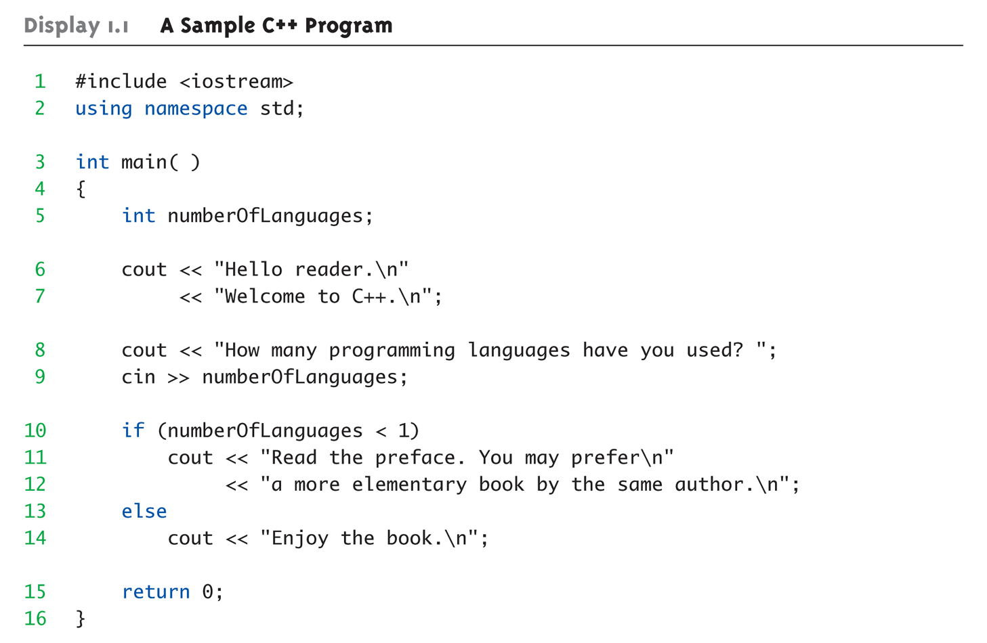
Display 1.1
A Sample C++ Program (1 of 2)
Copyright © 2008 Pearson Addison-Wesley. All rights reserved.
1-<number>
Notes:
main() may have parameters
return 0 -> int main()
cin is an object of class istream that represents the standard input stream. It corresponds to the cstdio stream stdin.
By default, most systems get their standard input from the keyboard, therefore cin is generally expected to get information from the user, although there are many cases where this can be redirected to some other source.
Because cin is an object of class istream, we can retrieve characters from cin either as formatted data using the extraction operator (>>) or as unformatted data using the read member function, among others (see istream).
cin is tied (see ios::tie) to the standard output stream cout, which means that cout's buffer is flushed (see ostream::flush) before each i/o operation performed on cin.
<< output operator or insertion operator

Slide 8
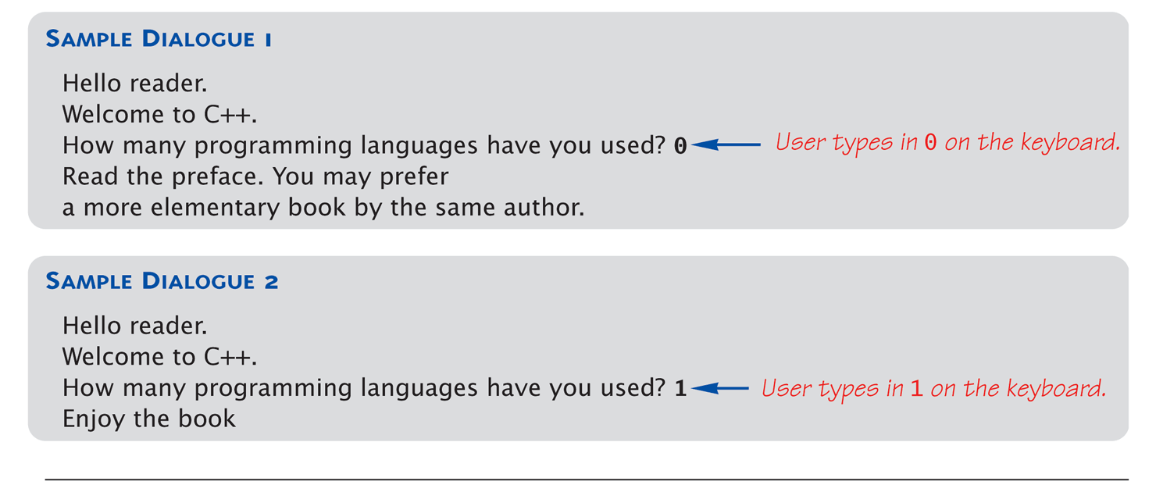
Display 1.1
A Sample C++ Program (2 of 2)
Copyright © 2008 Pearson Addison-Wesley. All rights reserved.
1-<number>

Slide 9
Lab Setup
Shelby 2119
Shelby 2122
Putty or secureCRT: Linux terminal on your windows PC
winSCP: Transfer files between your windows PC and a remote Linux server
Text Editor in Linux: Pico, vi, Emacs
Another option: Sun VirtualBox + Ubuntu (Linux)

Slide 10
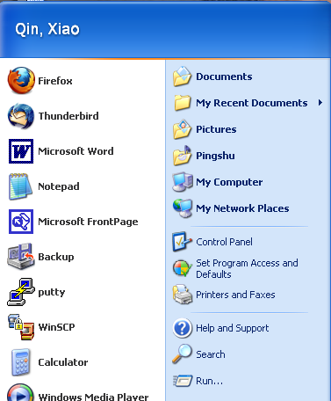
Secure Shell and FTP Clients
PuTTY is a free implementation of Telnet and SSH for Win32 and Unix platforms
WinSCP is a very flexible SFTP and SCP client for Windows

Slide 11
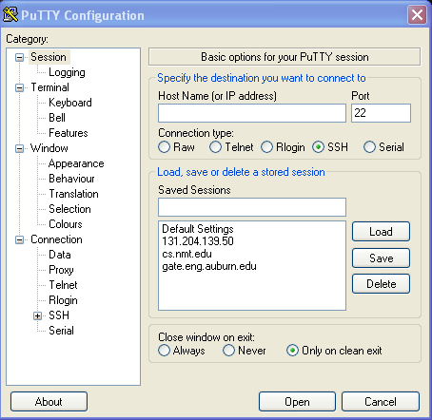
putty
gate.eng.auburn.edu
Notes:
Log into your H drive

Slide 12
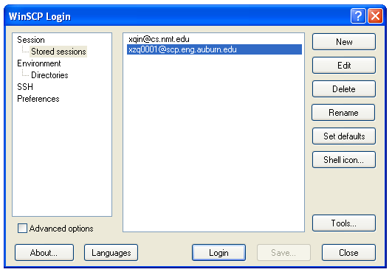
WinSCP http://www.siteground.com/tutorials/ssh/ssh_winscp.htm

Slide 13
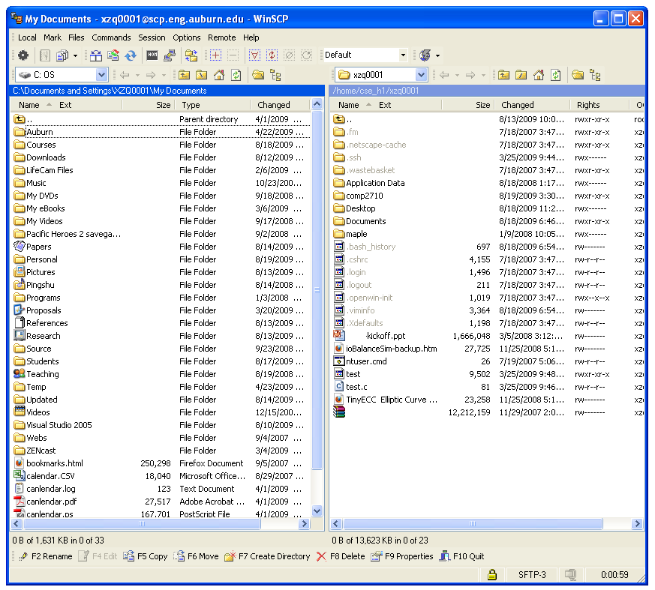
WinSCP (cont.)
Files at your Local PC
Files at the remote Linux server

Slide 14
Text Editors
Choose a text editor.
Some determining factors:
  What text editor is your professor using?
  Are you a computer science major or not?
  How much functionality do you want?
  After the initial learning curve, how fast do you want to be able to edit?

Slide 15
Pico
Pico is the easiest text editor to learn.
A non-graphical version of notepad.
The downside:
  Not every Unix/Linux machine has Pico installed.
  You can edit faster in other text editors after you’ve learned them well enough.
  Computer science majors who use Pico tend to be made fun of. (Just kidding)

Slide 16
Pico Basics
Open a file using “pico the_file”.
Move around just like you are in notepad.
Edit and delete using the normal keys.
Save using CTRL + O
Exit using CTRL + X
Go to a specific line number using CTRL + W, CTRL + T, and the number

Slide 17
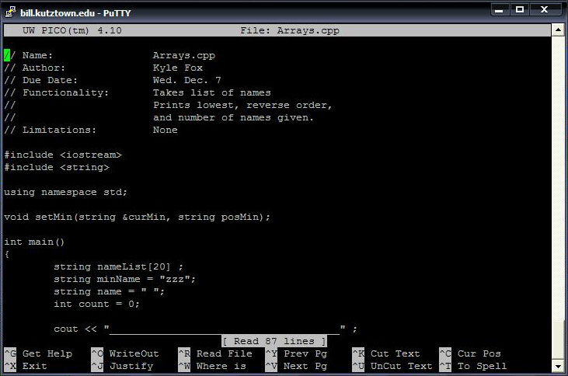
Pico Basic (cont.)

Slide 18
Vi
Vi is a feature rich editor located on almost all Unix/Linux machines around. Once learned, editing files is extremely fast.
The downside:
  It’s more complicated than Pico.
  It takes time to learn how to use vi.
  It’s easy to mess up your documents when you are first learning vi.

Slide 19


Vi and Bike
Photo Courtesy of David and Kelly Godzwa
Photo Courtesy of http://www.thejustinbowers.com
Notes:
It's a bit like riding a bike, once you learned it, you
don't want to walk anymore because it's so slow and less fun.
Reference: http://programmers.stackexchange.com/questions/86659/does-new-generation-of-programmers-use-emacs

Slide 20

Once you learned it, you don't want to walk anymore …
Photo Courtesy of Daniel Moyer Photography
Notes:
It's a bit like riding a bike, once you learned it, you
don't want to walk anymore because it's so slow and less fun.
Reference: http://programmers.stackexchange.com/questions/86659/does-new-generation-of-programmers-use-emacs

Slide 21
Vi Basics (1)
There are three modes to vi:
  Command mode (you start in this mode)
    It is used for entering commands
    The escape key always gets you back to command
  Insert/Append mode
    It is used for inserting or appending text
    From command mode, “a” will get you append mode, and “i” will get you insert mode.
  Line mode
    The “:” from command will get you to line mode.
    It is used for controls like saving and exiting.

Slide 22
Vi Basics (2)
Open a file using “vi the_file”.
Save using “w” (write) from line mode.
Quit using “q” (quit) from line mode.
Combine the two to save and quit “wq”.
Go to line using “#a_number” from line mode.
Delete a character using “x” from control mode.
Delete a line using “dd” from control mode.

Slide 23
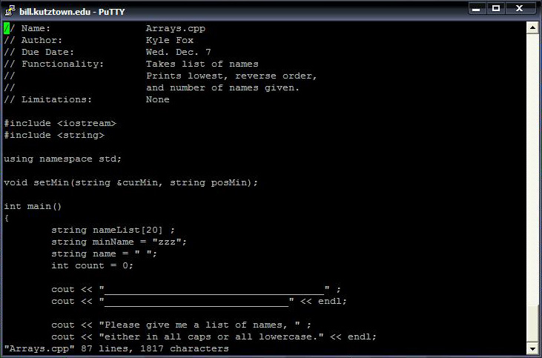
Vi Image

Slide 24
Emacs
Emacs is an extendable, customizable, versatile editor capable of doing much more than a regular editor.
It is able to be integrated with GDB, the debugger used for C++.
The downside:
  It is more complicated than Pico
  It’s going to take time to learn how to get around.

Slide 25
Emacs Basics(1)
Open a file using “emacs the_file”.
  Note: once emacs opens, you will need to use ctrl-l to move to the file you are editing.
Save a file using ctrl-x, ctrl-s
Exit using ctrl-x, ctrl-c
Go to line using alt+g, g
Stop emacs by using ctrl-g

Slide 26
Compiling a C++ Program
To compile a c++ program, use the g++ command. “g++ helloworld.cpp”
  Provided there are no errors, this will create an executable file called a.out.
  If you want to name your executable file, use the -o flag to specify a name. “g++ helloworld.cpp -o helloworld.out”

Slide 27
Running a C++ Program
Running a c++ program is easy, just type in the name of the executable file!
  “a.out”
There could be a minor issue however. If for some reason, that doesn’t work, try preceding the name with a ./
  “./a.out”

Slide 28
Break!
Let’s say you run your program, and realize it never stops! You are stuck in an infinite loop. You need a way to stop (or break) your program.
Use ctrl-c to stop a program running in an infinite loop

Slide 29
Core Files
If for some reason, you have a very bad error happen when you run your program, you may end up with a core dump.
What happens is that Unix saves all information about what happened to a file named “core”.
Make sure if this happens to you, that you remove the core file, because they are big, and can take up a lot of your space!

Slide 30
Wildcard
There exists a wildcard character. It is the asterix(*).
Wherever you put an asterix, Unix/Linux will try to put any character or word. So something like “*.cpp” will select every single .cpp file in your directory.
Careful! It can be handy, but dangerous! Using “rm *” would remove everything!

Slide 31
Summary
Characteristics of C++
C++ vs. Java
How to use putty and WinSCP?
How to use vi?
Compiling and running a C++ Program
1-<number>
Notes:
Give an example.

